Slide 1
OER & MOOC on Numeracy
Kees Hoogland
December 2020, part 3

Slide 2
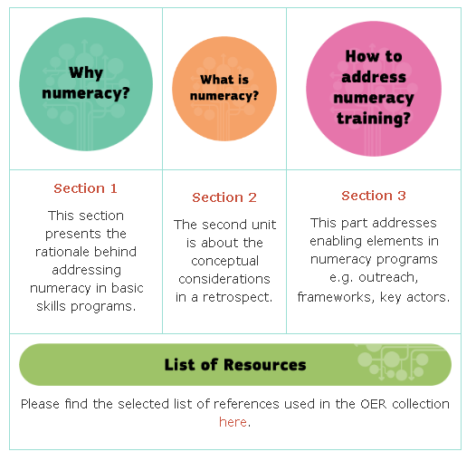
Webinar in three parts
Part 1 : Why Numeracy?
Friday 4th December 2020, 10h30 (CET)
Part 2 : What is Numeracy?
Thursday 10th December 2020, 10h30 (CET)
Part 3 : How to address Numeracy education?
Wednesday 16th December 2020, 10h30 (CET)

Slide 3
Webinar in three parts
Part 3 : How to address Numeracy education?
Wednesday 16th December 2020, 10h30 (CET)
“Although numeracy has always been an essential element in basic skills training programs, it is often not in the forefront for basic skills policies and practice. Therefore, one of our OER collections and MOOCs this year aim to provide an introduction to adult numeracy education.”
EBSN (2020). Retrieved: https://basicskills.eu/learn-with-us-on-epale-oer-mooc-on-numeracy-by-ebsn/

Slide 4
Webinar in three parts
Part 3 : How to address Numeracy education?
Wednesday 16th December 2020, 10h30 (CET)
1.1 Life long learning
1.2 Towards a Common European Numeracy Framework
1.3 Key players and resources

Slide 5
1.1 Life long learning
Further to this, the Council has adopted a Recommendation on Upskilling Pathways aiming to help adults acquire a minimum level of literacy, numeracy and digital skills or a specific upper-secondary level qualification (level 3 or 4 in the European Qualifications Framework (EQF)).
More information can be found on the Upskilling Pathways webpage.

Slide 6
1.2 Towards a Common European Numeracy Framework
1950 - 1975
1975 - 2000
2000 - 2025
2025 – 2050
Numeracy is the plethora of observed numerate social practices (integrated with the cultural, social, personal, emotional, and power relations)
Mathematics integrated with the cultural, social, personal, and emotional
Mathematics in contexts of everyday life
Basic (arithmetic) skills
arithmetic
realistic mathematics education
Numeracy/
mathematical literacy
Numeracy as a social practice

Slide 7
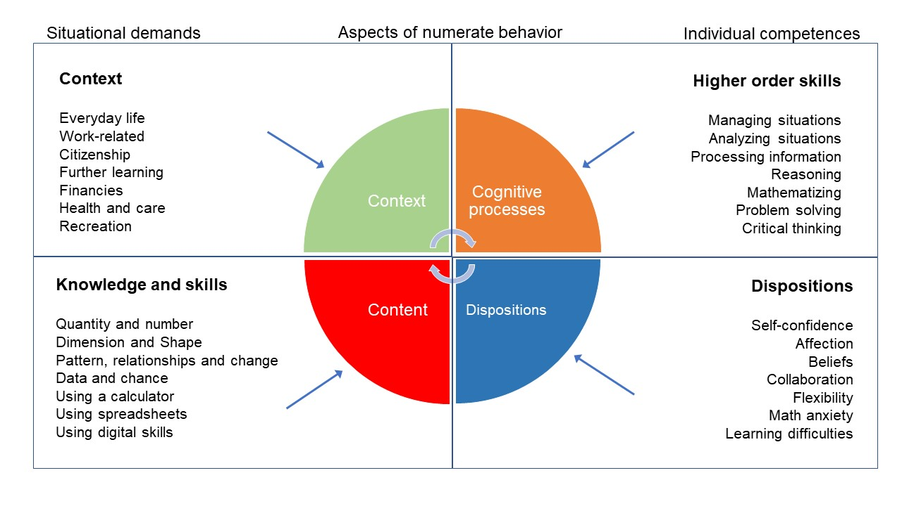
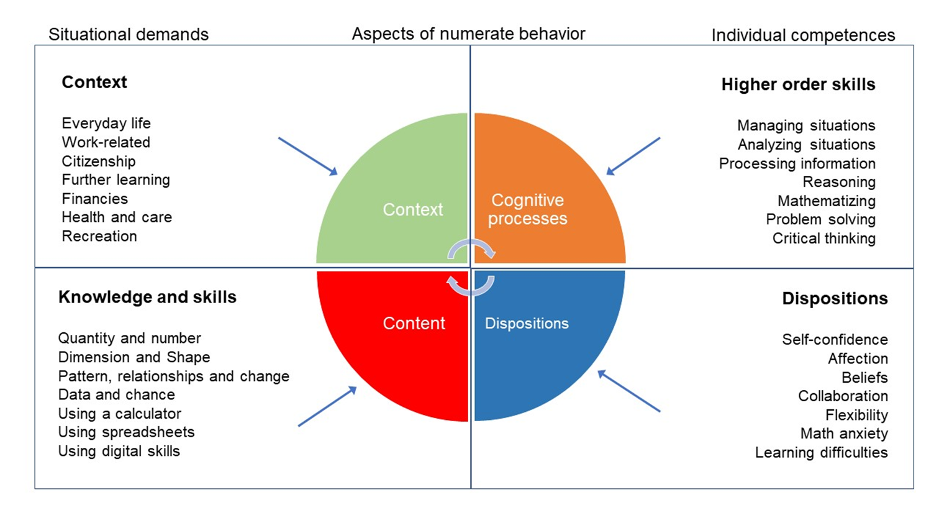
Towards a Common European Numeracy Framework
21st century skills

Slide 8
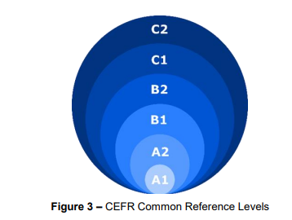
Common European Framework of Reference for Language (CEFR)
CEFR symposium 1992 Report of the Symposium (1992)
CEFR Companion Volume with New Descriptors 2018

Slide 9
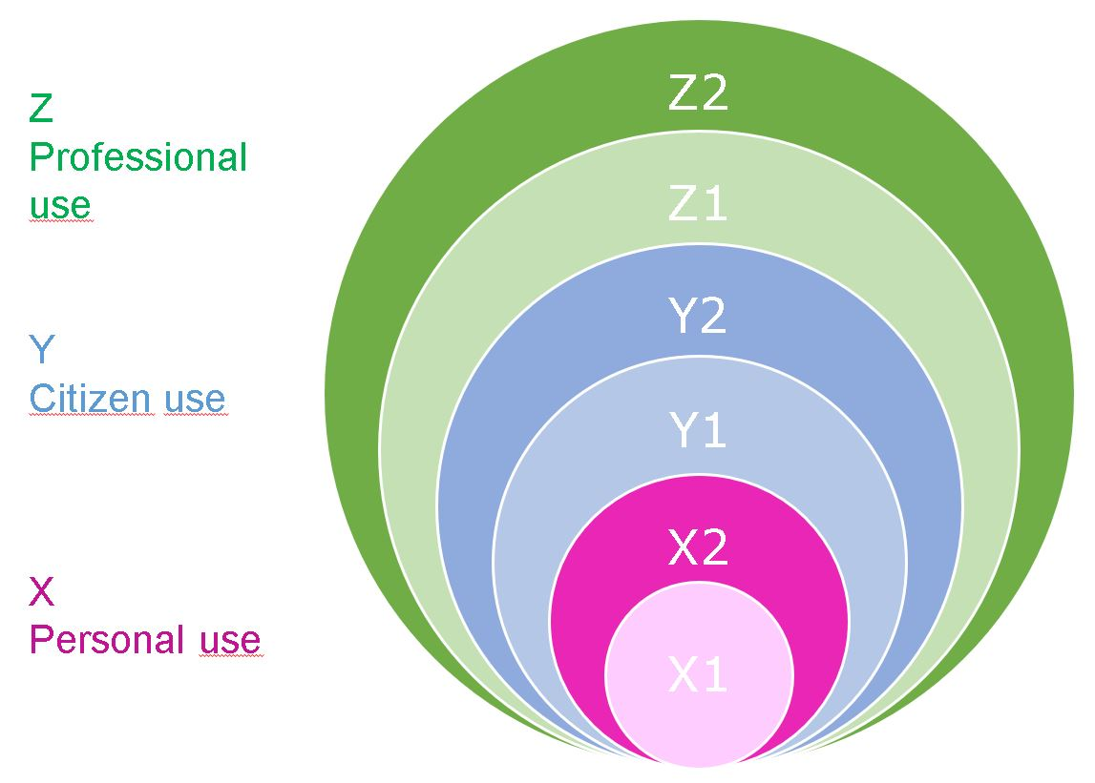
Common European Numeracy Framework
For each aspect of numeracy (or numerate behaviour) we create a 3 or 6 level rubric with suggestions for measuring /assessment tools.
Underpinned with literature
To be further validated
Notes:
Let us get bold and let us get a bit more practical

Slide 10
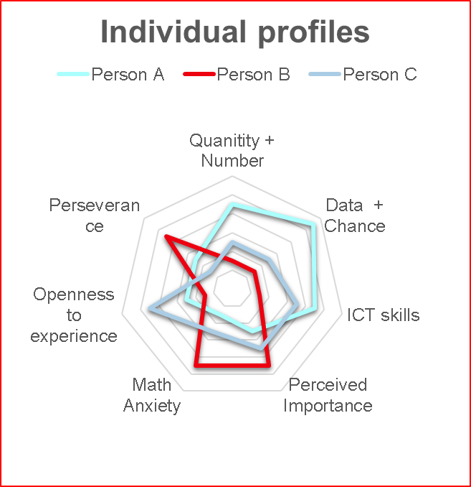
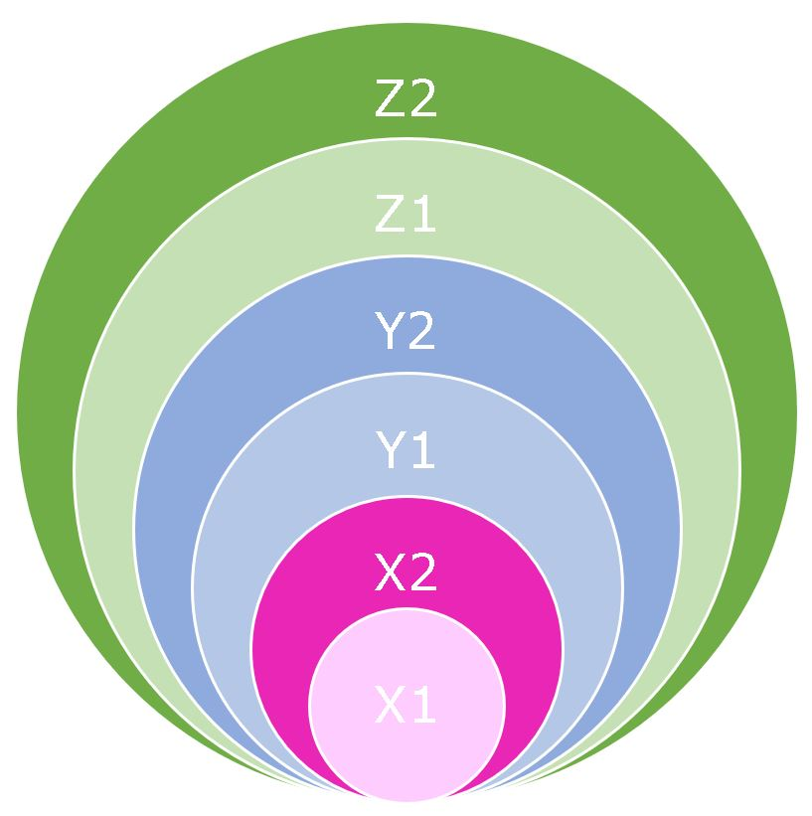
(Hypothetical) Learning Trajectories
-
Notes:
Let us get a bit more practical

Slide 11
Towards a Common European Numeracy Framework
Common language on concepts and relevant aspects
Broad interpretation of Numeracy
Including Professional Development Modules
Pre-release: 18th March 2021, 20h00 (CET) !!
Joined activity:
ALM - Virtual Seminar Series
Erasmus+ CENF Virtual International Multiplier Event
Registration, due soon: https://alm-online.net/alm-2020-virtual-seminar-series

Slide 12
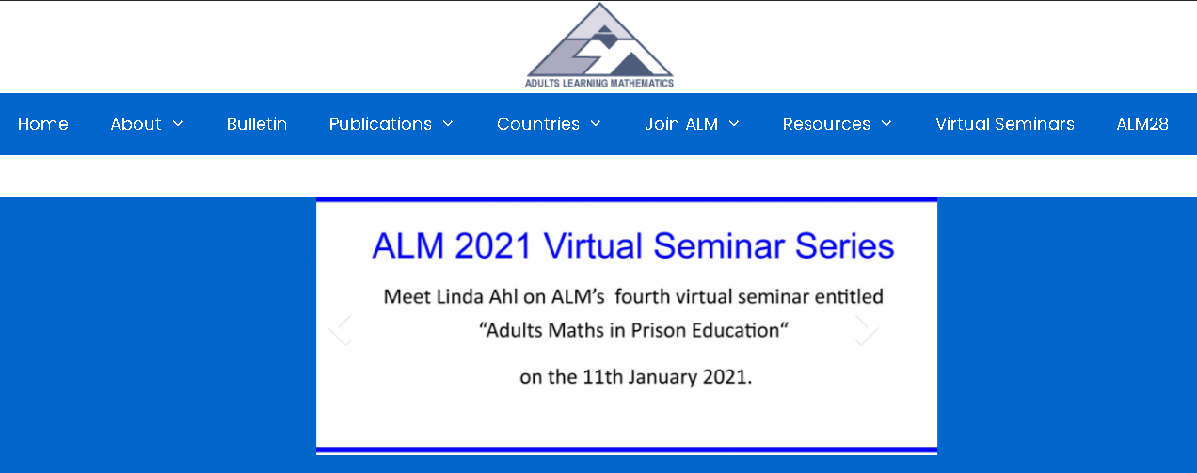
Adults Learning Mathematics (ALM)
International network for researchers, practitioners, and policy makers
Conferences, webinars, bulletin, website
https://alm-online.net/

Slide 13
Adults Numeracy Network (ANN)
USA-based network for researchers, practitioners, and policy makers
Conferences, webinars, newsletter, website
https://adultnumeracynetwork.org/

Slide 14
Conferences (researchers, practitioners, policy makers)
CERME (every 2 year: …, 2017, 2019, 2021 (Feb, short virtual), 2022(Feb: Bolzano, Italy)
Thematic Working group TWG07: Adults Mathematics Education
Free of charge snake-preview: Wed, 3rd Feb. 2021, 10:00 - 12:00 TWG07 !!!
ICME (every 4 year: …, 2012, 2016, 2021 (hybrid, Sjanghai ), 2024 Melbourne, … )
Topic study groups: http://www.icme13.org/topic_study_groups
For instance: ALM, in and for work, mathematical literacy, language, equity, sffect, motivation, …
EBSN (every year)
Literacy and numeracy: https://basicskills.eu/
https://www.cerme12.it/

Slide 15
End of presentation
Kees Hoogland | professor Mathematical and Analytical Competences of Professionals | Knowledge Centre Learning and Innovation | HU University of Applied Sciences Utrecht | Padualaan 97 | 3584 CH Utrecht | The Netherlands | Ph.+316 3410 1701 |
https://www.gecijferdheid.nl/kees-hoogland-appointed-professor-of-mathematical-and-analytical-competences-of-professionals/?lang=en

